Slide 1

Department of computer Application University Institute of Technology Rajiv Gandhi Proudyogiki VishwaVidyalaya
A MINOR PROJECT PRESENTATION ON
CLASSROOM SYSTEM

Slide 2
.
SUBMITTED BY SUBMITTEDTO:-
DEPARTMENT OF COMPUTER APPLICATION :-
PROJECT GUIDANCE BY:-
MR.JAYNARAYAN THAKRE AMITA NAGWANSHI
0101CA211007
ATUL PANDEY HIMANSHU JHARIYA
0101CA211024
ANJANA PATNEY ISHA JAIN
0101CA211026
DHEERESH KUSHWAH
CLASS:-MCA 3rd SEM
.

Slide 3
Index
Introduction
Features
Tools and Technologies used
Use Case Diagram
Output Screens
Pros
Conclusion

Slide 4
Introduction
An organized and systematic office solution is essential for all universities and organizations. There are many departments of administration for the maintenance of college information and student databases in any institution. All these departments provide various records regarding students. Most of these track records need to maintain information about the students. This information could be the general details like student name, address, performance, attendance etc or specific information related to departments like collection of data.

Slide 5
Features
Easy Accessibility:
Records can be easily accessed and store and other information respectively.
User Friendly:
The app will be giving a very user-friendly approach for all user.

Slide 6
Easy maintenance:
Classroom system design as easy way. So maintenance is also easy.

Slide 7
Tools and technologies
HTML
CSS
JAVASCRIPT

Slide 8
Use case diagram
USER REGISTRATION
USER LOGINOGIN
User
VIEW ASSIGNMENT VID
LECTURES
QUIZRECORDED VIDEO
LOGOUT

Slide 9
Admin signup
Admin login
Add assignment
to dor list
Add lectures
Admin
User list
Remove users
RLog Out

Slide 10
Output screens

Slide 11
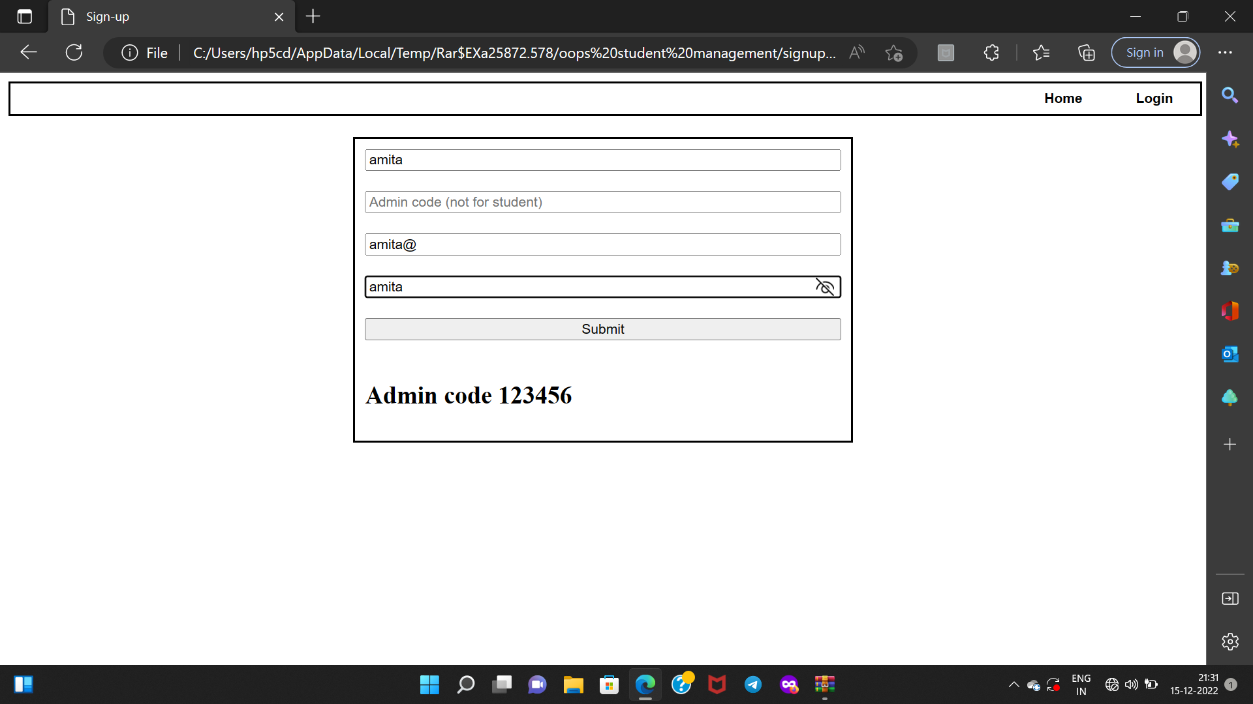
Registration page

Slide 12
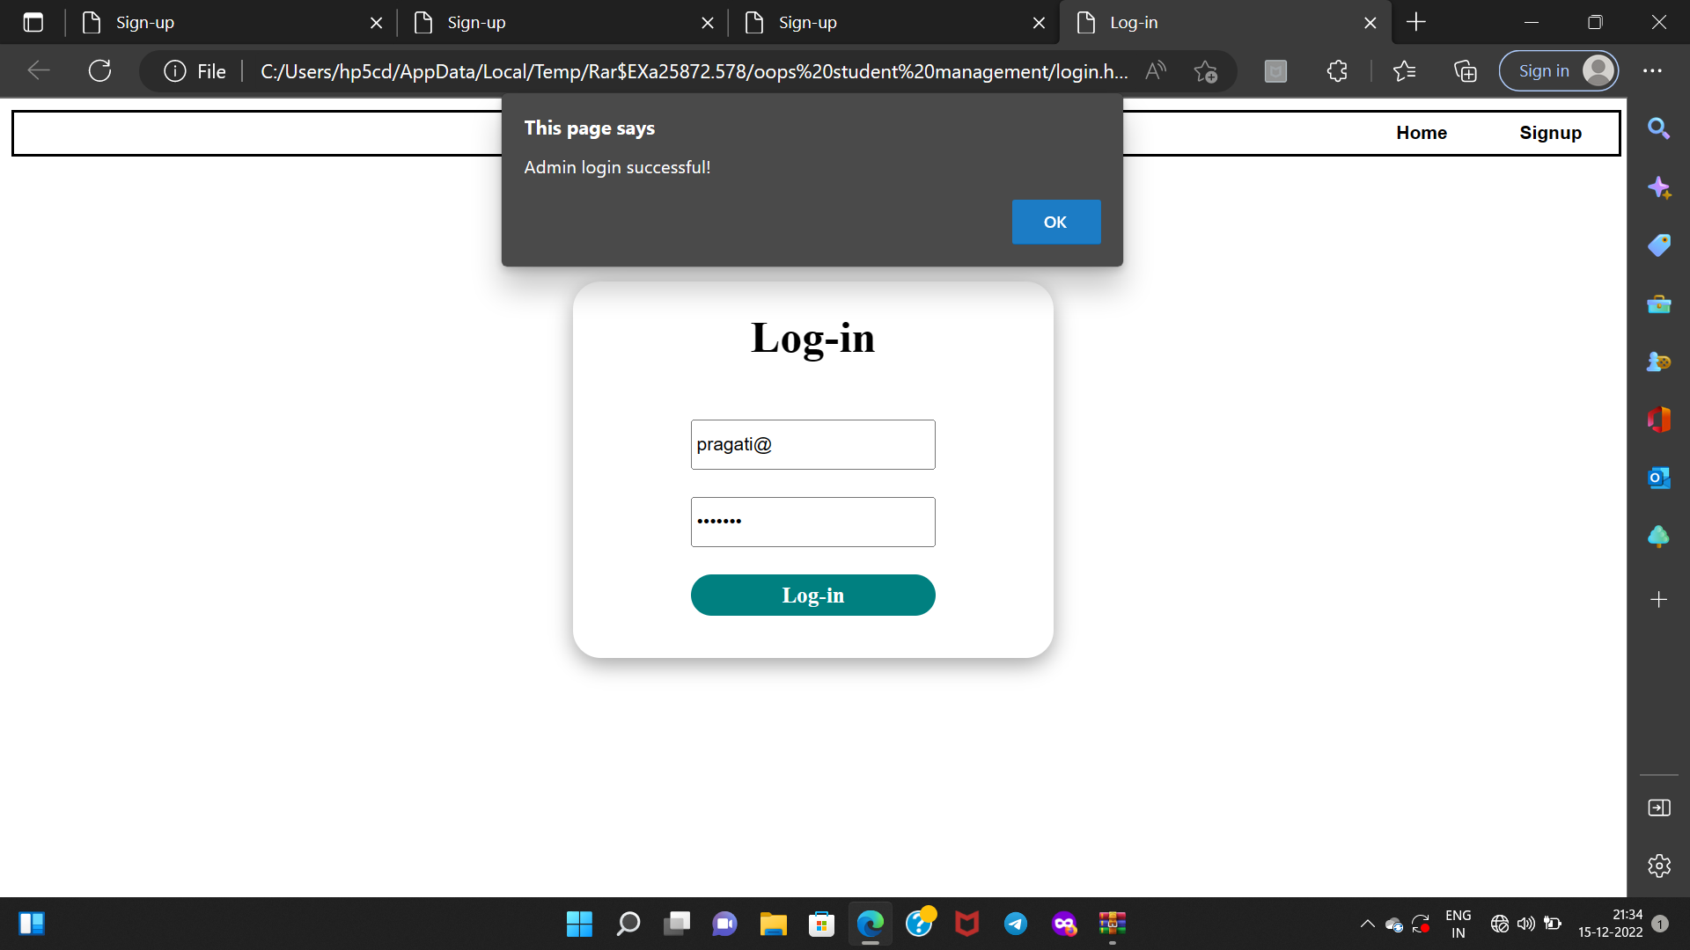
Login page

Slide 13
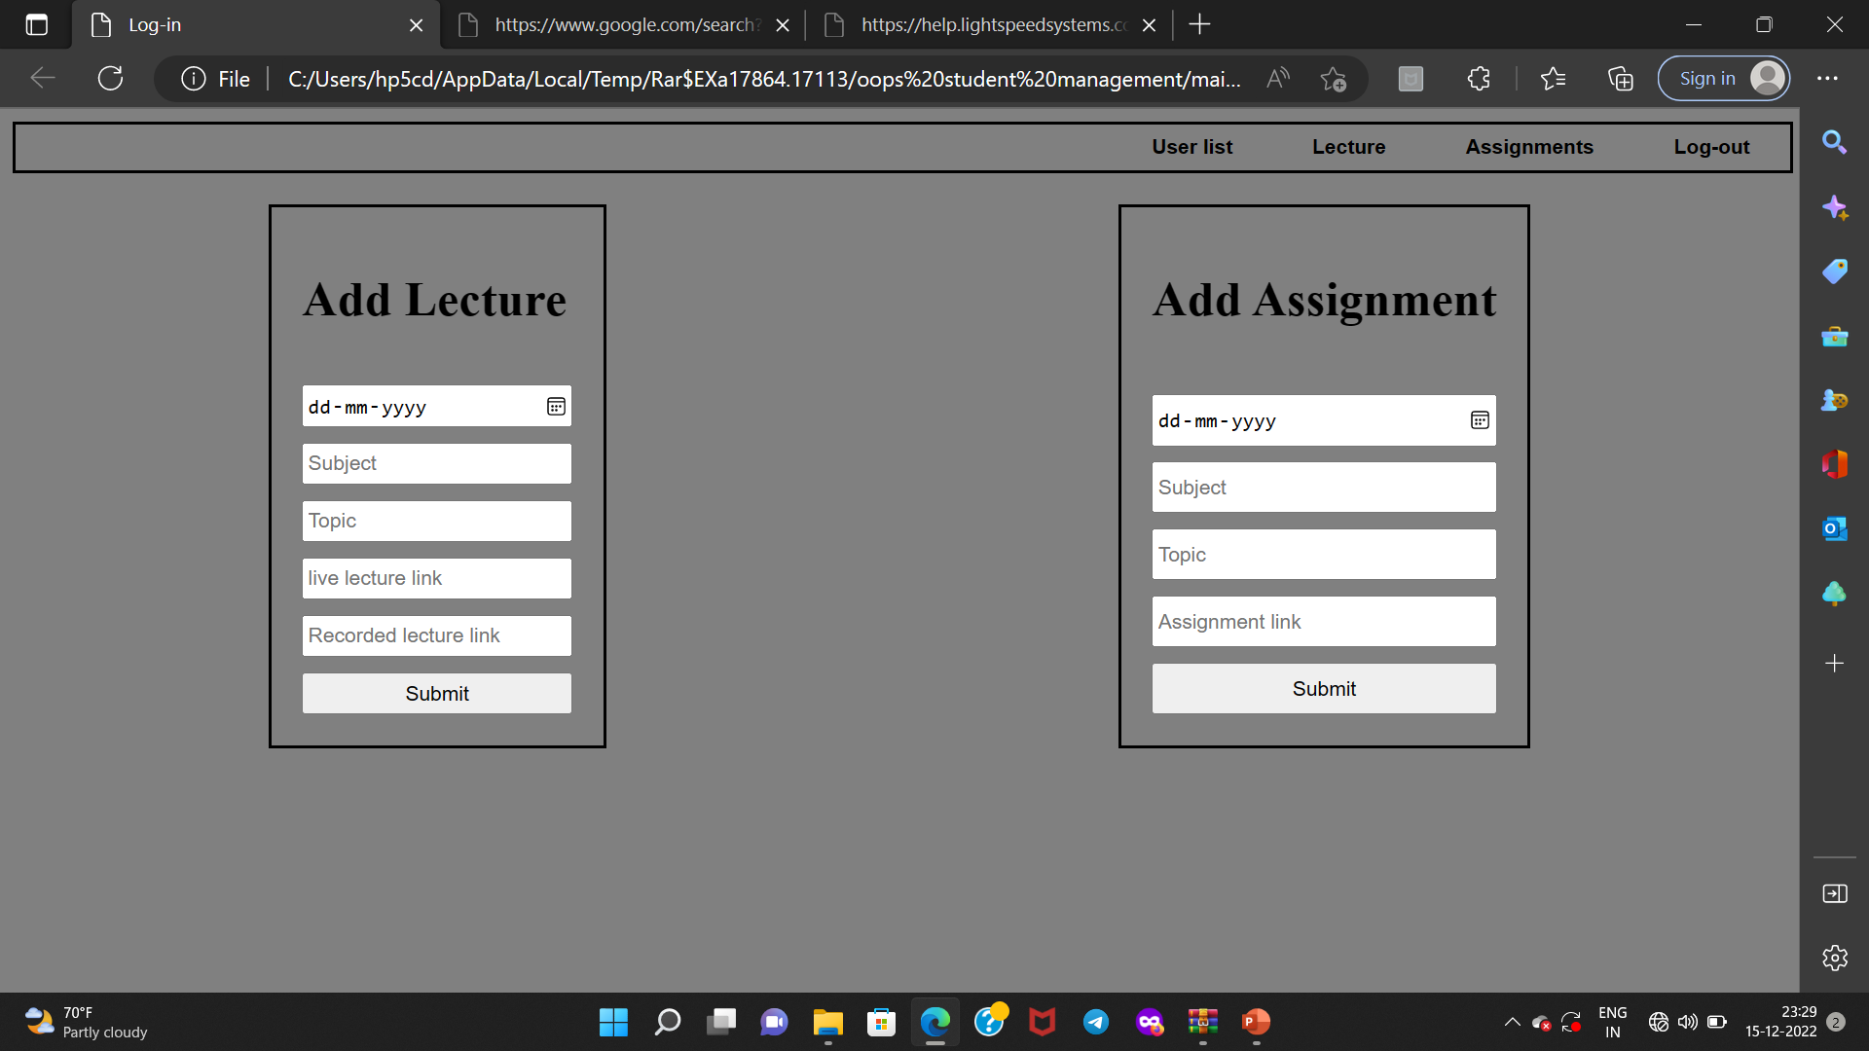
Add assignment and lectiures

Slide 14
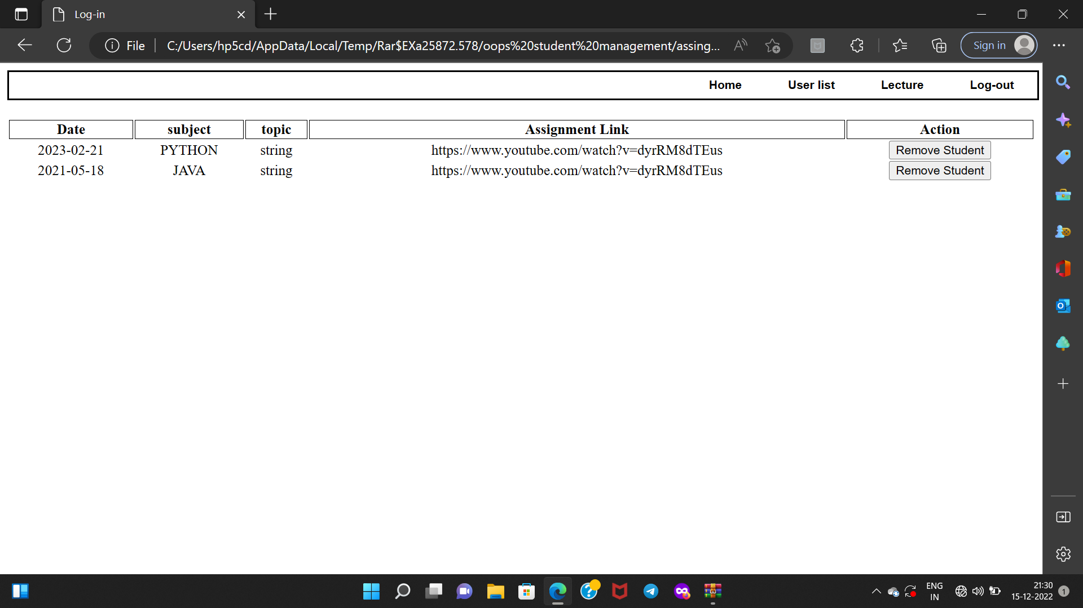
-:Output:-

Slide 15
Pros of classroom system

Slide 16
Pros
Create and manage lectures , assignment and recorded videos.
Add material to your assignment ,such as youtube videos.
Set up lectures and assignment.
Track classwork and submit assignment.
Protect data and set permission for your users.
Add and Remove users by Admin in this classroom system.
Get 24/7 accessibility.

Slide 17
conclusion
Simplicity is never simple.As we have seen in this project the process of creating a user friendly and straight forward platform . The most important element of CLASSROOM SYSTEM is allowing students an opportunity to understand that your rules are a part of a best education possible.
Teaching is very important job and once you get your management system an order you will be enjoying teaching more .
Encourages active learning processes that allow for effective teaching and learning in the classroom.
Structured enough to provide a blueprint while being flexible enough to allow for individual teacher personality and teaching style.

Slide 18
Thank you

